Slide 1
These slides are intended to help you learn to do it yourself. If you plan to reuse this content, please email me at mike@billiondollargraphics.com or call 703-626-5657.
Thank you! ☺

Slide 2
Box 4
Box 3
Box 2
Box 1
Element 1
Element 2
Element 3
Element 4
Element 5
Element 6
Element 7
Element 8

Slide 3
1
Draw Rounded Rectangle

Slide 4
2
Adjust Corners (Yellow Diamonds)

Slide 5
3
Fill Black with (Heavy) Grey Line

Slide 6
4
Draw Circle
>Change to White Fill and Black Stroke
Circle Fill to Gradient
>Select Shape Fill, Gradient, Choose Diagonal Fill
Duplicate Circle and Shrink 2x
>Remove Stroke from Duplicates
>Medium Circle: Reverse Gradient Direction
Align Center
>Select Arrange/Align and Distribute/Align Center

Slide 7
5
5
Align Circles Center
>Select the 3 Circles and Align Center Horizontal and Vertical
>Group Circles

Slide 8
6
6
Duplicate Grouped Circles
>Move 1 Group to Each End
>Select all Circle Groups-Distribute Horizontally and Align to Center

Slide 9
7
Draw Lines
>Change 1 End Type to Round
>Duplicate and Distribute Evenly Across Circles
>Extend Every Other Line Evenly

Slide 10
8
Add Text Boxes
Element 1
Additional information here.
Element 3
Additional information here.
Element 5
Additional information here.
Element 7
Additional information here.
Element 2
Additional information here.
Element 4
Additional information here.
Element 6
Additional information here.
Element 8
Additional information here.

Slide 11
8
Or… Place Text in Circles for Space Saving Layout
Element 1
Element 2
Element 3
Element 4
Element 5
Element 6
Element 7
Element 8

Slide 12
9
Make Arrow

Slide 13
10
Change Fill to White
>Remove Stroke (if needed)
>Change Fill to Gradient

Slide 14
11
Duplicate Arrows

Slide 15
12
“Distribute Horizontally” and “Group” the arrows.

Slide 16
13
Draw Boxes and Place Arrows Under “Conveyor Belt.” Be sure to “group” the boxes and conveyor belt into one group and select that group.
Box 1
Box 2
Box 3
Box 4
Element 1
Element 2
Element 3
Element 4
Element 5
Element 6
Element 7
Element 8

Slide 17
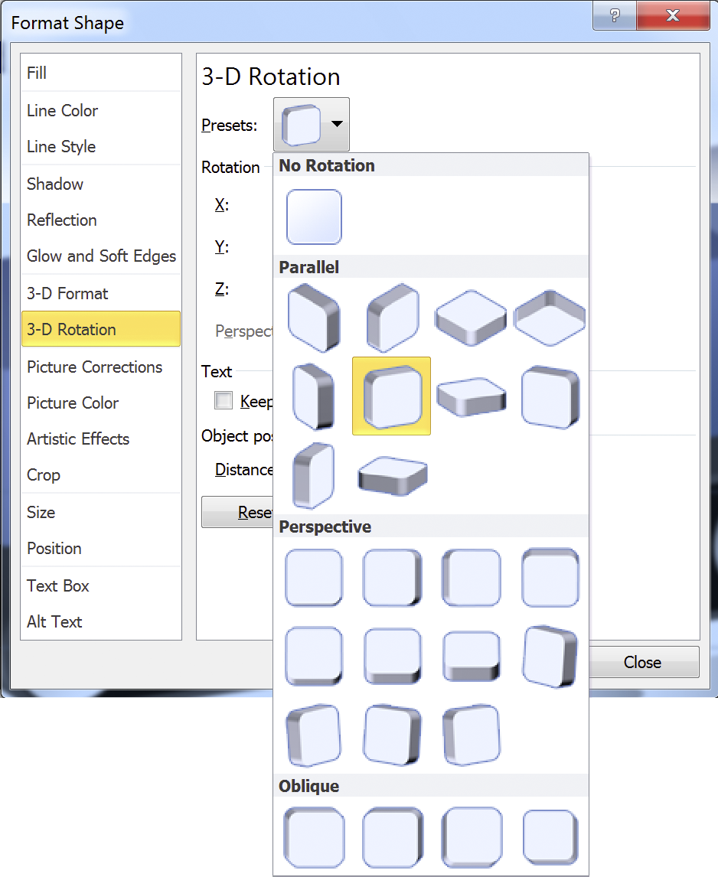
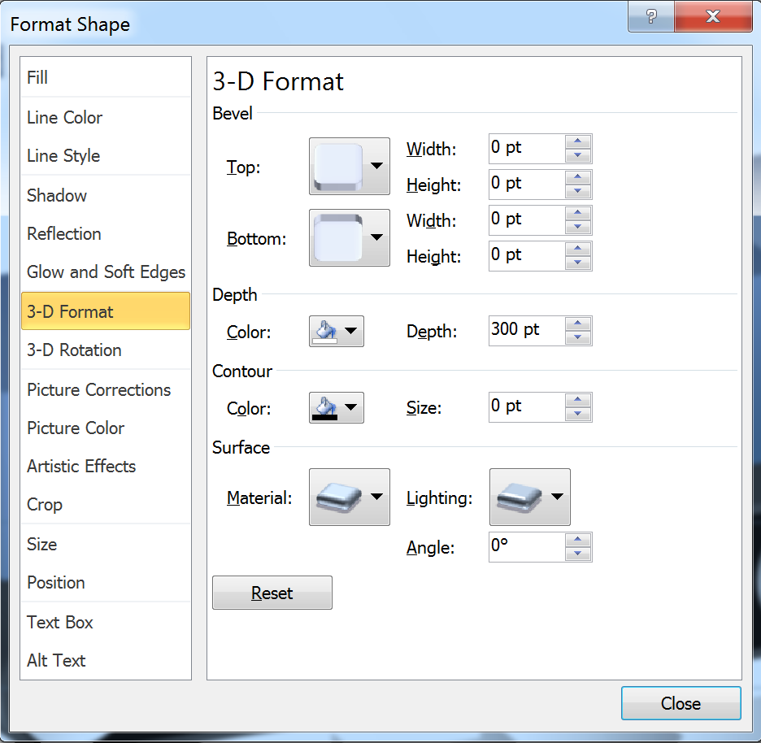
14
Rotate and add depth to the conveyor belt group. (Only rotate the arrow group. There is no need to add depth to the arrows.)

Slide 18
15
Change the depth and reposition as needed for the boxes. (For example, the conveyor belt may be 300units deep and the boxes may be 200 units deep.) Ta-daaa…
Box 4
Box 3
Box 2
Box 1
Element 1
Element 2
Element 3
Element 4
Element 5
Element 6
Element 7
Element 8

